Slide 1
Reordering Grammar
Miloš Stanojević

Slide 2
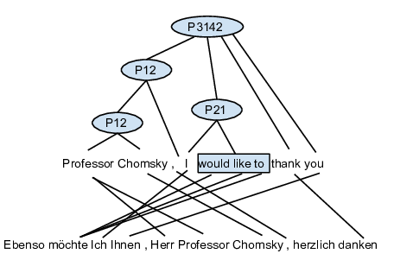
PETs as a representation of reordering patterns
We've already seen few papers that use ITG for preordering (Tromble and Eisner, Neubig ...).
ITG as a representation of reordering has few restructions:
- only permutation
- only binarizable permutations
We try to solve this two problems with:
- permutation trees
- minimal phrases
Just like previous models we are making a parsing model which predicts these “reordering trees” before translation.

Slide 3
PETs as a representation of reordering patterns
Let's pretend this is a standard parsing task.
How would we learn a parsing model?
Would it be good enough?
What could be potential problems?

Slide 4
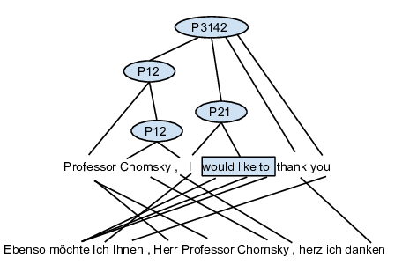
PETs as a representation of reordering patterns
Let's pretend this is a standard parsing task.
How would we learn a parsing model?
Would it be good enough?
What could be potential problems?
Labels are too abstract
  Lexicalization
  Label splitting
Many PETs per permutation
  In training we have (exponentially) many trees per permutation
  In testing we need to sum over many trees per permutation

Slide 5
Inducing Reordering Grammar
We could see that this is an unsupervised (or at least partially supervised) task:
  We don't know exact trees from which to learn but just have constraints of what are not possible trees
  We know how do we reorder but we don't know the cause (no linguistic cues). We need to find these more specific labels that explain the “cause”

Slide 6
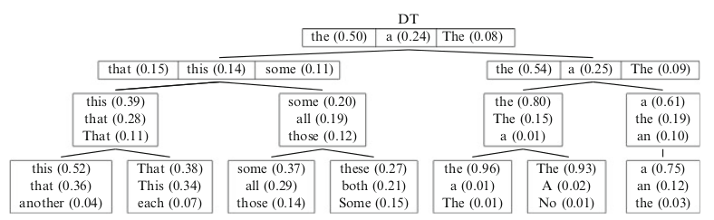
Let's talk about
Latent Variable parsing
Why do it?
  Labels that are visible are actually not specific enough. For example:
    There is a difference between NP subject and NP object
    a subject NP is 8.7 times more likely than an object NP to expand as just a pronoun
  In our case this problem is even more extreme: instead of labels like NP we have <1,2> and <2,1> which hide behind themself the reason why they are doing that operation for example
    <2,1> could mean
      “I am doing inversion because on this span there is a verb phrase” or it could also be
      “I am doing inversion because on this span there is a subject”...
    Which one is right? We don't know, but we know that these kinds of things exist and they are hidden
    That's why we create <2,1>¹ and <2,1>²

Slide 7
Let's talk about
Latent Variable parsing
How is it done?
  EM (Expectation Maximization)
  In standard setting we collect counts and then minimize
  Because counts are hidden we instead collect expected counts and normalize them (for several iterations)
  So if we have only two trees T1 and T2 with probability 0.1 and 0.2 which contain some rule what would be the expected count of that rule?

Slide 8
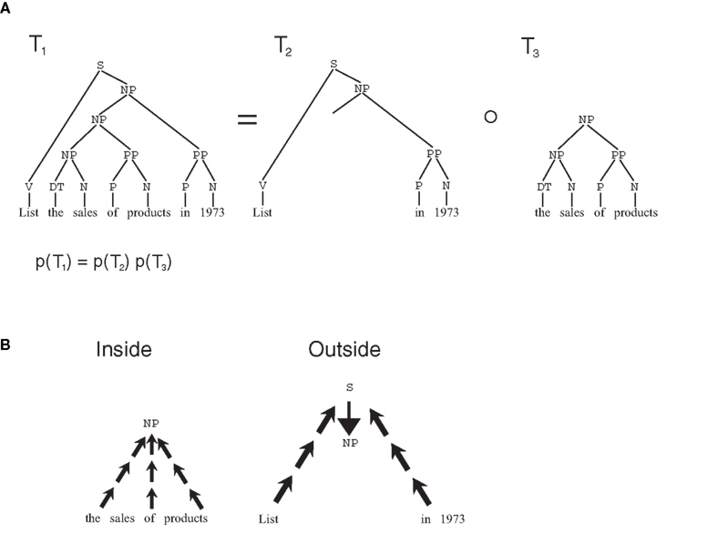
Summing all trees
Tricky part is how to sum over all trees of which there could be exponentially many
We use dynamic programming – Inside-Outside

Slide 9
Our case vs. monolingual parsing
In monolingual parsing we know the bracketing while in our case even that is uncertain
Luckily Inside-Outside easily covers this case too

Slide 10
Ok, so we split the non-terminals
Is that all?
Let's say we have a rule
P2413 -> P12 P21 P12 P21
And we split every non-terminal.
What could be the problem?
Imagine we split every non-terminal into 30 new non-terminals.

Slide 11
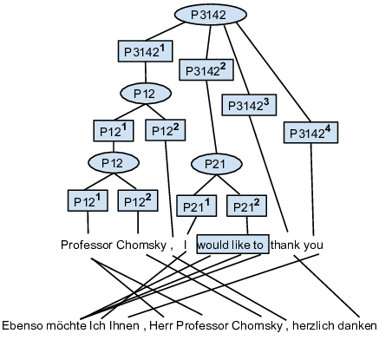
“Unarization”
30⁶ = 729000000
30+30²*5 =4530

Slide 12
Some details
We convert alignments to permutations by using minimal phrases where necessary
Rare words (count<3) are replaced with “UNKNOWN” token
Unaligned words make use of operator P01 and P10

Slide 13
Now that we have a grammar how do we decode?
Standard CKY+ to build the chart of all trees
We can do Viterbi to get the best tree.
  Is that a good idea?
We want to find a permutation with highest probability and not the derivation with highest probability
For computing the probability of permutation we want to sum:
  Over all non-terminals
  Over all bracketings
that produce the same permutation
Exact solution is NP-complete.
  What can we do to approximate it?

Slide 14
Sampling
We sample lots of trees (10000) and then compute their probability by relative frequency
Problem: space is huuuuge so most of the trees appear only once which makes distribution unreliable
Still, the distribution says something
If by sampling we get these three permutations what can we guess from them:
  4 3 2 1 6 5
  4 2 3 1 6 5
  3 2 4 1 5 6

Slide 15

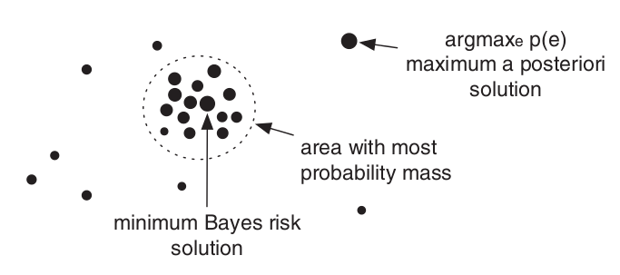
We incorporate this “similarity” in our decision rule
Instead of taking the most probable permutation we take “the least risky one” under some loss (or similarity) function
Used very often in many
structure prediction tasks
(for example machine
translation with BLEU loss)
Imagine we have n samples of permutations. Length of each permutation is k. What is the complexity of this algorithm if our loss function is Kendall tau?

Slide 16



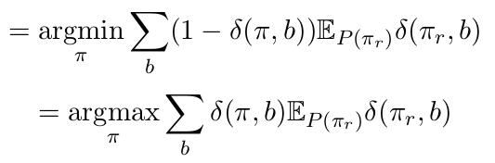
Fast MBR with linear loss
What is the complexity now?

Slide 17
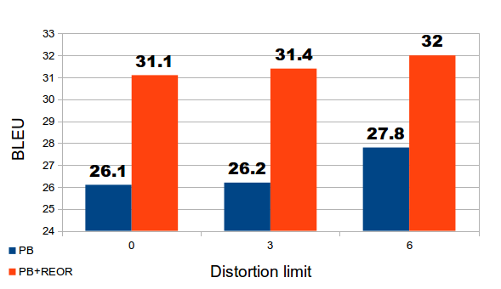
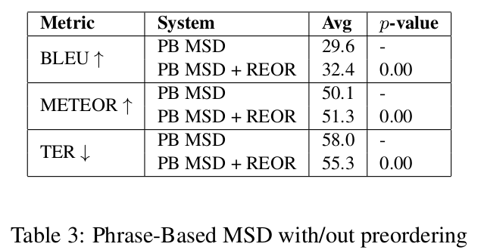
Results with English-Japanese

Slide 18
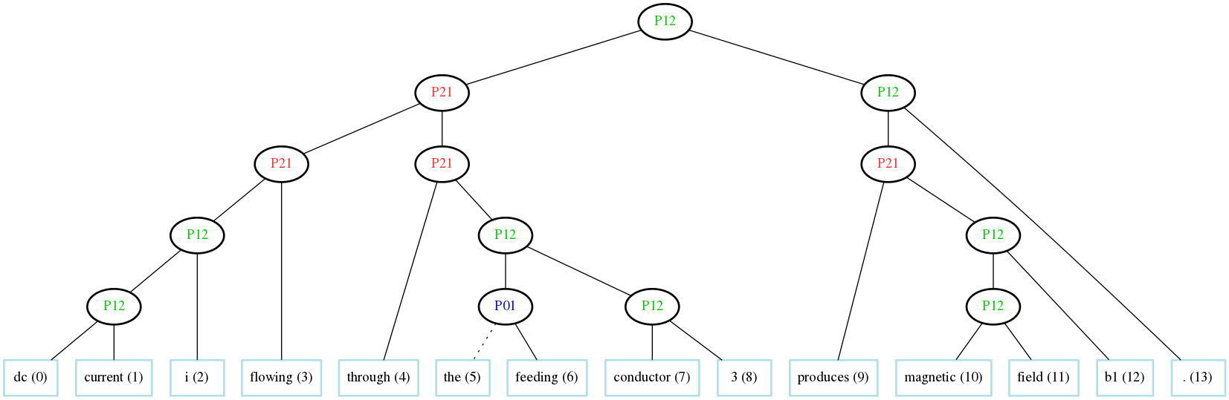
Results with English-Japanese

Slide 19
How does it compare to other work we've seen before?

Slide 20
How does it compare to other work we've seen before?
Does not have two steps bud does everything in one go:
  Predict the brackets (tree structure)
  Predict the labels on the tree
Does not pick only one tree but considers them all trees both during training and during testing
It is fully probabilistic (no perceptrons and similar stuff)
Uses no syntax (unlike Dyer) and captures syntactically non-isomorphic reordering patterns
Can capture non-ITG reorderings
Basically standard parsing (use can extend it with all the standard stuff you might use in parsing).
Suggestions on how it could be improved?
Questions?

